Slide 1

CISC360 Computer Architecture
Lesson 6
Operating System Support

Slide 2
OS Objectives and Functions
Convenience
  Making the computer easier to use
Efficiency
  Allowing better use of computer resources

Slide 3
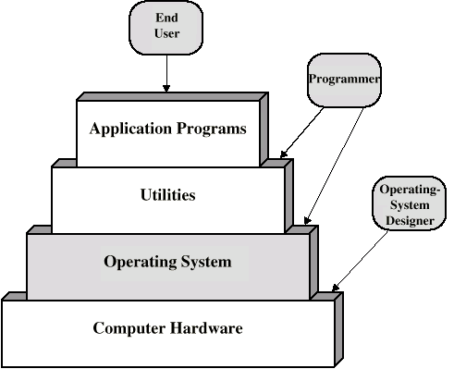
Layers and Views of a Computer System

Slide 4
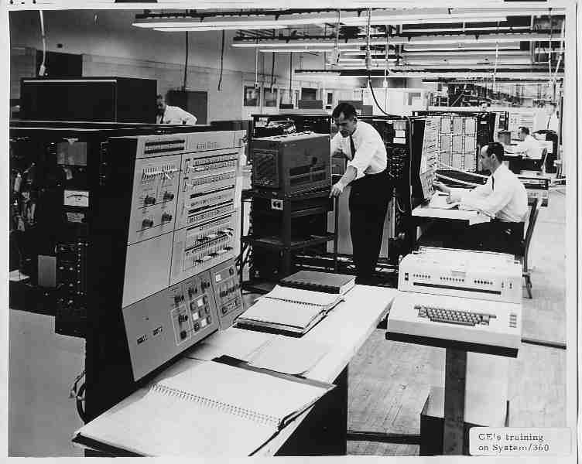

Operating System
Services
Program creation
Program execution
Access to I/O devices
Controlled access to files
System access
Error detection and response
Accounting

Slide 5
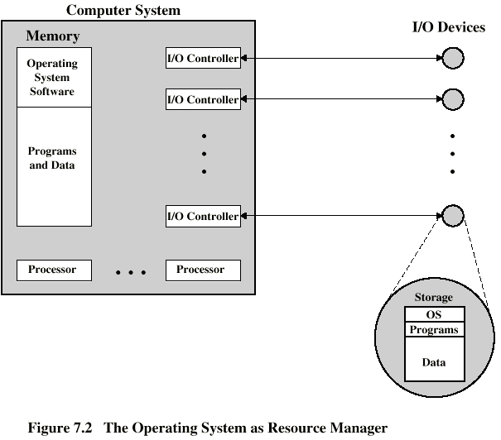
O/S as a Resource Manager

Slide 6
Types of Operating System
Interactive
Batch
Single program (Uni-programming)
Multi-programming (Multi-tasking)
REAL-TIME

Slide 7
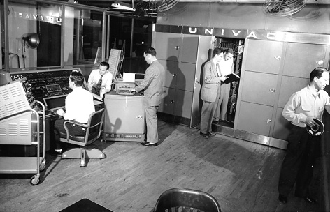
Early Systems
Late 1940s to mid 1950s
No Operating System
Programs interact directly with hardware
Two main problems:
  Scheduling
  Setup time

Slide 8
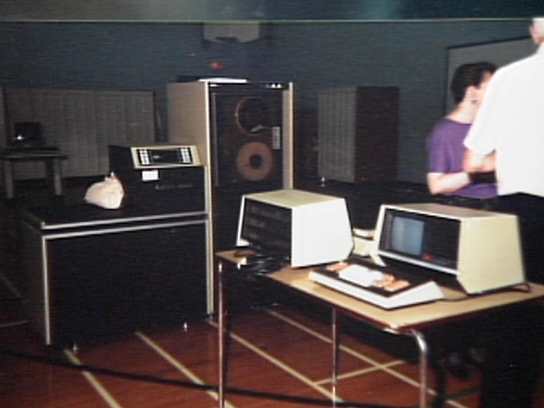
Simple Batch
Systems
Resident Monitor program
Users submit jobs to operator
Operator batches jobs
Monitor controls sequence of events to process batch
When one job is finished, control returns to Monitor which reads next job
Monitor handles scheduling

Slide 9
Job Control Language
Instructions to Monitor
Usually denoted by $ or some other special character
e.g.
  $JOB
  $FTN
  ... Some Fortran instructions
  $LOAD
  $RUN
  ... Some data
  $END
Predecessor to scripting languages (Burroughs WFL)

Slide 10
Desirable Hardware Features
Memory protection
  To protect the Monitor
Timer
  To prevent a job monopolizing the system
Privileged instructions
  Only executed by Monitor
  e.g. I/O
Interrupts
  Allows for relinquishing and regaining control

Slide 11
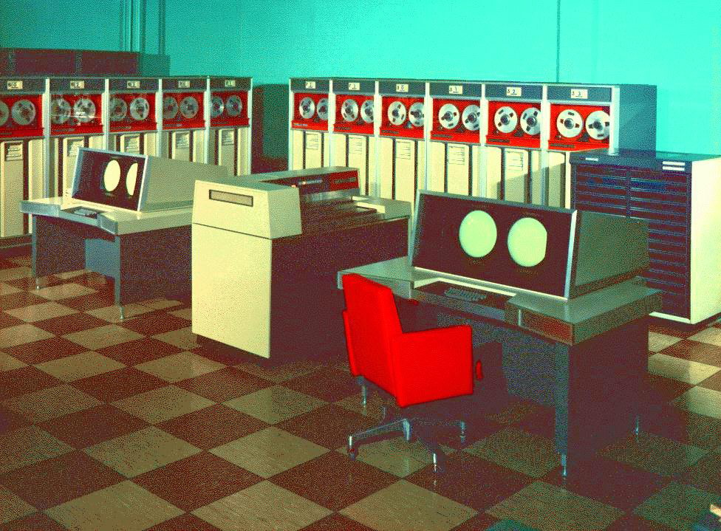
Multi-programmed Batch Systems
I/O devices very slow
When one program is waiting for I/O, another can use the CPU

Slide 12
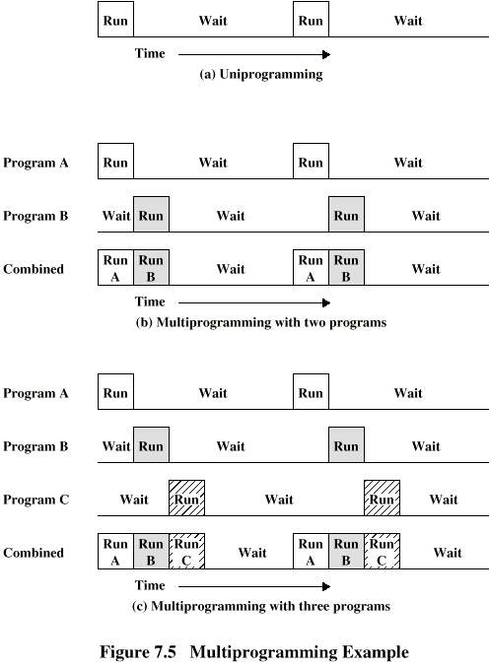
Single Program

Slide 13
Multi-Programming with
Two Programs

Slide 14
Multi-Programming with
Three Programs

Slide 15
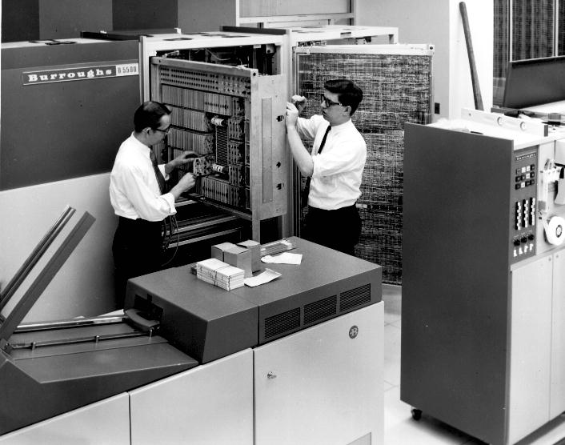
Time Sharing Systems
Allow users to interact directly with the computer
  i.e. Interactive
Multi-programming allows a number of users to interact with the computer

Slide 16
Scheduling
Key to multi-programming
Long term
Medium term
Short term
I/O

Slide 17
Long Term Scheduling
Determines which programs are submitted for processing
i.e. controls the degree of multi-programming
Once submitted, a job becomes a process for the short term scheduler
(or it becomes a swapped out job for the medium term scheduler)

Slide 18
Medium Term Scheduling
Part of the swapping function (later…)
Usually based on the need to manage multi-programming
If no virtual memory, memory management is also an issue

Slide 19
Short Term Scheduler
Dispatcher
Fine grained decisions of which job to execute next
i.e. which job actually gets to use the processor in the next time slot

Slide 20
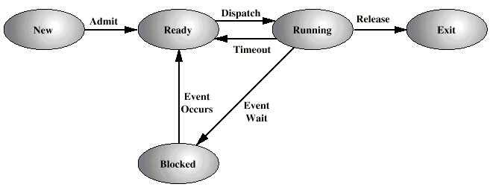
Process States

Slide 21
Process Control Block
Identifier
State
Priority
Program counter
Memory pointers
Context data
I/O status
Accounting information

Slide 22
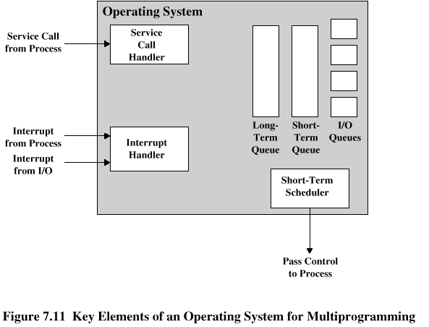
Key Elements of O/S

Slide 23
Process Scheduling
Process
Request
Long-Term
Queue
Short-Term
Queue
End
CPU
I/O
I/O Queue
I/O
I/O Queue
I/O
I/O Queue

Slide 24
Memory Management
Uni-program
  Memory split into two
  One for Operating System (monitor)
  One for currently executing program
Multi-program
  “User” part is sub-divided and shared among active processes
Memory PROTECTION

Slide 25
Swapping
Problem: I/O is so slow compared with CPU that even in multi-programming system, CPU can be idle most of the time
Solutions:
  Increase main memory
    Expensive
    Leads to larger programs
  Swapping

Slide 26
What is Swapping?
Long term queue of processes stored on disk
Processes “swapped” in as space becomes available
As a process completes it is moved out of main memory
If none of the processes in memory are ready (i.e. all I/O blocked)
  Swap out a blocked process to intermediate queue
  Swap in a ready process or a new process
  But swapping is an I/O process...

Slide 27
Partitioning
Splitting memory into sections to allocate to processes (including Operating System)
Fixed-sized partitions
  May not be equal size
  Process is fitted into smallest hole that will take it (best fit)
  Some wasted memory
  Leads to variable sized partitions

Slide 28
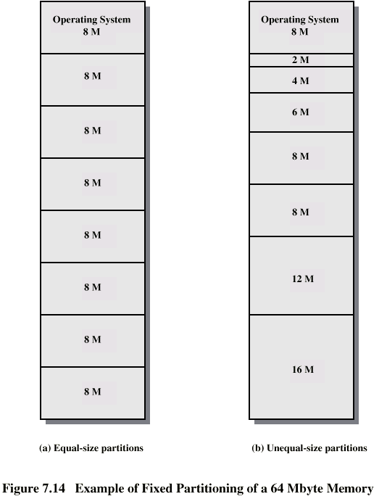
Fixed
Partitioning

Slide 29
Variable Sized Partitions (1)
Allocate exactly the required memory to a process
This leads to a hole at the end of memory, too small to use
  Only one small hole - less waste
When all processes are blocked, swap out a process and bring in another
New process may be smaller than swapped out process
Another hole

Slide 30
Variable Sized Partitions (2)
Eventually have lots of holes (fragmentation)
Solutions:
  Coalesce - Join adjacent holes into one large hole
  Compaction - From time to time go through memory and move all hole into one free block (c.f. disk de-fragmentation)

Slide 31
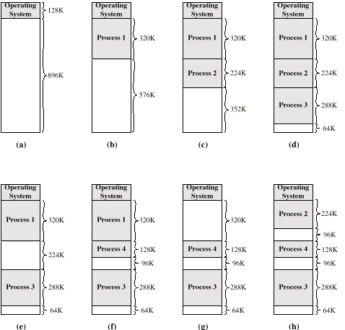
Effect of Dynamic Partitioning

Slide 32
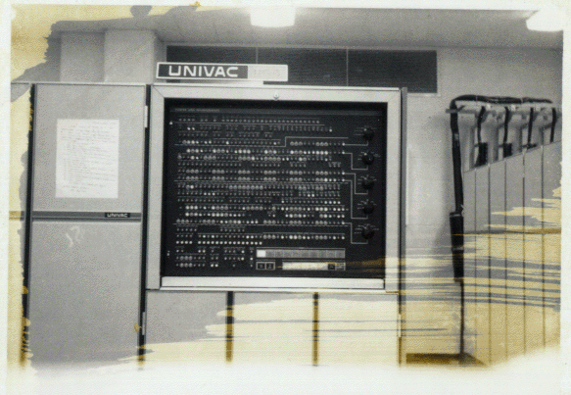
Relocation
No guarantee that process will load into the same place in memory
Instructions contain addresses
  Locations of data
  Addresses for instructions (branching)
Logical address - relative to beginning of program
Physical address - actual location in memory (this time)
Automatic conversion using base address

Slide 33
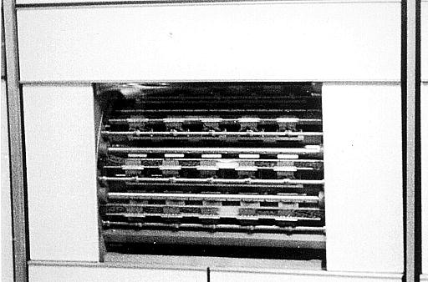
Paging
Split memory into equal sized, small chunks -page frames
Split programs (processes) into equal sized small chunks - pages
Allocate the required number page frames to a process
Operating System maintains list of free frames
A process does not require contiguous page frames
Use page table to keep track
Pages stored in lower member of memory hierarchy (extended storage, disk, drum)

Slide 34
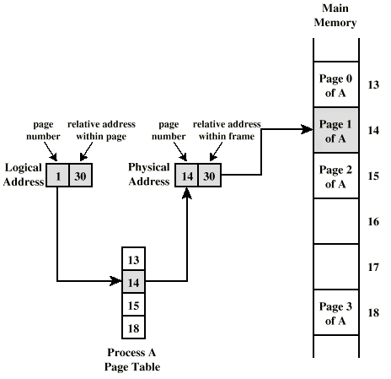
Logical and Physical Addresses - Paging

Slide 35
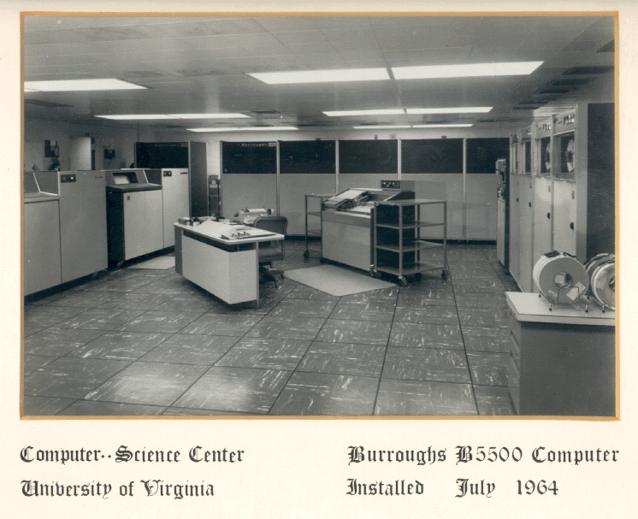
Virtual Memory
Demand paging
  Do not require all pages of a process in memory
  Bring in pages as required
Page fault
  Required page is not in memory
  Operating System must swap in required page
  May need to swap out a page to make space
  Select page to throw out based on recent history

Slide 36
Thrashing
Too many processes in too little memory
Operating System spends all its time swapping
Little or no real work is done (WHY?)
Disk light is on all the time
Solutions
  Good page replacement algorithms
  Reduce number of processes running
  Fit more memory

Slide 37
Bonus
We do not need all of a process in memory for it to run
We can swap in pages as required
So - we can now run processes that are bigger than total memory available!
Main memory is called real memory
User/programmer sees much bigger memory - virtual memory

Slide 38
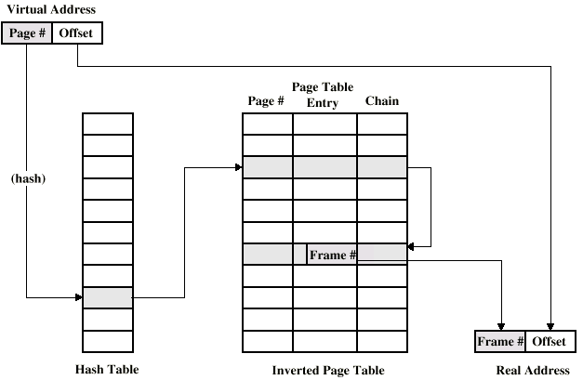
Page Table Structure

Slide 39
Segmentation
Paging is not (usually) visible to the programmer
Segmentation is visible to the programmer
Usually different segments allocated to program and data
May be a number of program and data segments

Slide 40
Advantages of Segmentation
Simplifies handling of growing data structures
Allows programs to be altered and recompiled independently, without re-linking and re-loading
Lends itself to sharing among processes
Lends itself to protection
Some systems combine segmentation with paging

